Slide 1
IBM MACHINE LEARNING CAPSTONE
Personalized Online Course
Recommender System
Exploring content-based, clustering, collaborative-filtering,
and predictive recommendation methods
Mubashir Ali | November 2026
01

Slide 2
IBM MACHINE LEARNING CAPSTONE
Why a course recommender?
Online catalogs contain hundreds of courses. A useful recommender should turn sparse enrollment history and course metadata into relevant next steps for each learner.
307
233,306
33,901
126
courses in genre catalog
course interactions
unique learners
rated course items
Hypothesis 1: course genres and text similarity can identify relevant alternatives.
Hypothesis 2: learner–course interactions reveal complementary preferences.
Hypothesis 3: combining multiple model families gives a stronger decision basis.
02

Slide 3
IBM MACHINE LEARNING CAPSTONE
Data and analytical workflow
01
02
03
04
Explore
→
Represent
→
Recommend
→
Evaluate
course genres
and enrollment patterns
genre vectors,
BoW and embeddings
similarity,
clusters and CF
ranking coverage,
RMSE and accuracy
Implemented notebook surfaces
EDA and feature engineering
User-profile and course-similarity recommenders
K-means clustering, KNN, NMF and neural embeddings
Regression and classification rating prediction
03

Slide 4
IBM MACHINE LEARNING CAPSTONE
Exploratory data analysis: the catalog
The genre catalog is broad, but concentrated in technical and data-oriented subjects.
Backend developmen
78
Feature engineering
Machine learning
69
Binary genre indicators encode course topics.
Course titles and descriptions are transformed into sparse BoW vectors.
Weighted genre profiles summarize each learner’s interests.
Database
60
Data analysis
56
Data science
38
Cloud computing
37
Big data
36
Source: course_genre.csv (307 rows)
Python
28
04

Slide 5
IBM MACHINE LEARNING CAPSTONE
Exploratory data analysis: demand signals
Enrollment activity is highly uneven: a small set of foundational courses dominates interactions.
Python for data science
14,936
Implication
Introduction to data sci
14,477
Popularity is a strong baseline, but it can over-recommend common introductory courses.
Big data 101
13,291
Hadoop 101
10,599
Data analysis with Pytho
8,303
Personalization is needed to surface less obvious, high-fit alternatives.
Data science methodology
7,719
Machine learning with Py
7,644
Spark fundamentals I
7,551
Source: ratings.csv; counts are interaction rows by item.
05

Slide 6
IBM MACHINE LEARNING CAPSTONE
Content-based recommendation
Learner profile + course genres
Two complementary content signals
1
Aggregate a learner’s enrolled-course genres into a weighted profile.
Genre profile
Interpretable interests such as Python, Machine Learning and Data Analysis.
2
Compare the profile with candidate course genre vectors.
BoW similarity
3
Rank unseen courses by cosine similarity / recommendation score.
Text-level similarity captures related course titles and descriptions.
06

Slide 7
IBM MACHINE LEARNING CAPSTONE
Similarity and clustering recommenders
Course similarity
User-profile clustering
Build a course-by-course similarity matrix from BoW features.
For each learner, combine recommendations from enrolled courses.
Filter already-seen courses and rank by similarity.
Reduce high-dimensional profiles with PCA.
Group learners with K-means.
Recommend popular unseen courses within the learner’s cluster.
Best suited for: “more like this” discovery
Best suited for: cohort-level personalization
07

Slide 8
IBM MACHINE LEARNING CAPSTONE
Collaborative filtering models
Interaction history supports recommendations based on collective behavior rather than course metadata.
KNN
NMF
Neural network
Neighborhood-based
similar learners/items
Latent factors from
user–item matrix
Learned user and
course embeddings
Key trade-off
Collaborative filtering can discover unexpected matches, but cold-start learners and sparse histories remain challenging.
08

Slide 9
IBM MACHINE LEARNING CAPSTONE
Predictive rating models
Regression
Classification
Predict a continuous rating score from user and course embedding features.
Predict a rating mode or class from the same embedding-based representation.
Evaluation: RMSE / MAE
Evaluation: accuracy / F1
These models make the recommendation problem measurable as supervised prediction.
09

Slide 10
IBM MACHINE LEARNING CAPSTONE
Evaluation plan
Each model family answers a different product question; evaluation should reflect the intended use.
Model family
Primary question
Useful metrics
Content / clustering
Are recommendations relevant and novel?
Recall@K, coverage, unseen courses
KNN / NMF
Can we predict held-out interactions?
RMSE, MAE, ranking metrics
Regression
How close is the predicted score?
RMSE, MAE
Classification
Can we identify the rating mode?
Accuracy, precision, recall, F1
Current repository status: notebooks contain the modeling workflow, but saved evaluation outputs are not included.
10

Slide 11
IBM MACHINE LEARNING CAPSTONE
From notebook to learner experience
A Streamlit interface can make the models inspectable and useful without hiding their assumptions.
1
Select a course
2
Choose a strategy
3
Review results
Choose an enrolled or seed course.
Similarity, profile, cluster or CF.
See ranked courses and rationale.
Recommended explanation fields
similar genres • similar course text • cluster popularity • predicted rating
11

Slide 12
IBM MACHINE LEARNING CAPSTONE
Conclusions and next steps
What this project establishes
Next steps
A full recommender-system workflow from EDA through model families.
Multiple representations: genres, BoW, interaction matrices and embeddings.
A principled basis for comparing relevance, novelty and prediction quality.
Extend the holdout evaluation to ranking and novelty metrics.
Tune thresholds and K values using held-out users/interactions.
Build and deploy the Streamlit demo with transparent explanations.
Thank you
12

Slide 13
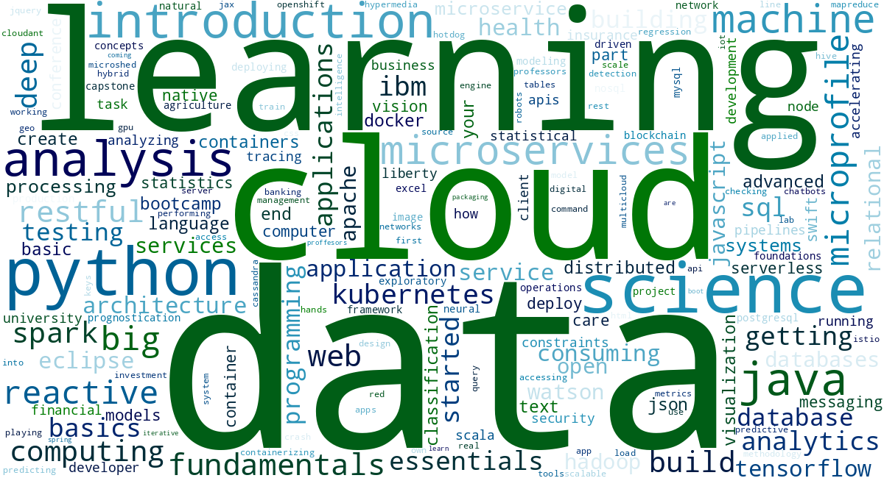
IBM MACHINE LEARNING CAPSTONE
Course-title word cloud
After lowercasing, tokenization and removal of generic stopwords, the catalog is dominated by data and cloud vocabulary.
Prominent terms
data (89)
learning (32)
cloud (32)
science (30)
python (27)
analysis (27)
Source: 307 course titles; counts are post-preprocessing token frequencies.
13

Slide 14
IBM MACHINE LEARNING CAPSTONE
Collaborative-filtering workflows
KNN
NMF
Neural embeddings
Build an item-item similarity matrix from the training user-item matrix. For a held-out item, combine the learner’s ratings on its nearest neighbors using similarity-weighted averaging.
Factorize the non-negative user-item matrix into learner factors W and course factors H. Estimate a missing rating with the dot product W[u] · H[:, i].
Map user and course IDs to learned vectors, combine the embeddings in a neural network, and output a predicted rating score.
Input → representation → score
Input → representation → score
Input → representation → score
14

Slide 15
IBM MACHINE LEARNING CAPSTONE
Measured collaborative-filtering comparison
Reproducible holdout experiment: 80/20 random split, 186,644 train interactions, 46,662 test interactions, random_state=42.
Model
RMSE
MAE
Interpretation
Item-item KNN (k=20)
0.894
0.760
Best of the tested baselines
NMF (15 factors)
2.958
2.811
Weak with zero-filled sparse matrix
Finding
KNN is the strongest measured baseline here. NMF needs missing-data-aware training or stronger regularization before it is a fair production candidate.
Metrics are rating-prediction metrics; they do not replace ranking, coverage or novelty evaluation.
15

Slide 16
IBM MACHINE LEARNING CAPSTONE
Evaluation results for recommendation quality
The next evaluation layer should measure the recommender as a ranking system, not only as a rating predictor.
Coverage
Novelty
Recall@K
How much catalog?
How surprising?
How relevant?
Fraction of courses ever recommended.
Share of unseen or long-tail courses.
Held-out courses recovered in top K.
Recommended reporting: compare these metrics across user-profile, course-similarity and clustering recommenders at the same K.
16

